Slide 1

IPV4 and IPV6 - Sockets
Dr. S.F.Rodd
Professor, Dept. of CSE, GIT

Slide 2
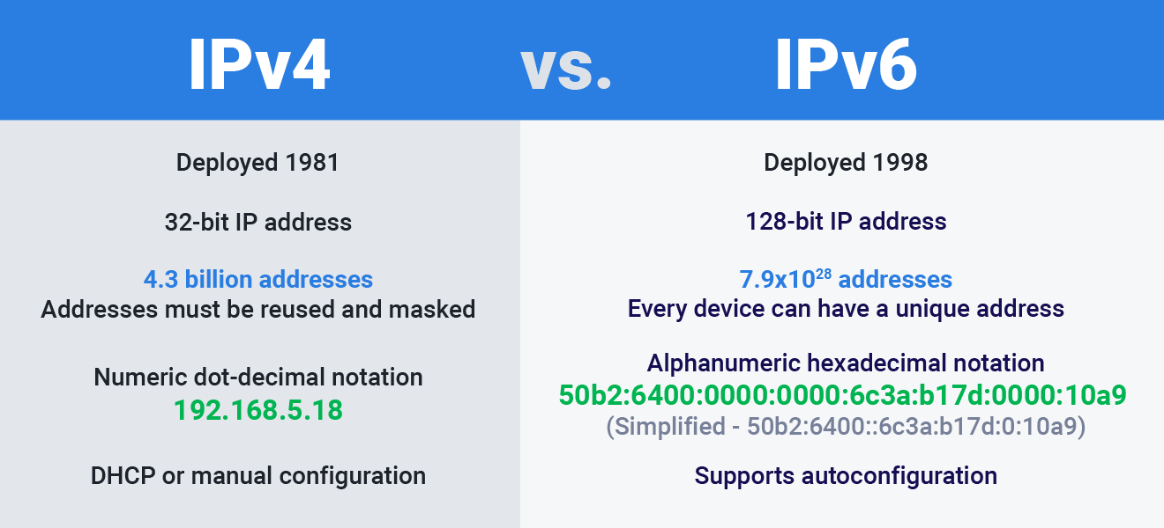

Slide 3
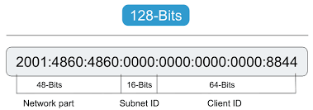
IPV6 Address
2001:0000:3238:DFE1:63:0000:0000:FEFB

Slide 4
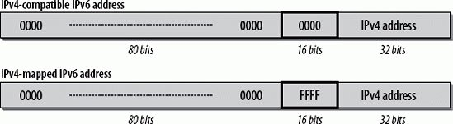

Slide 5
IPV4 and IPV6 Interoperability
Transition will be gradual from IPV4 to IPV6
During this transition phase, existing IPV4 applications must continue to work with newer IPV6 Applications
IPV6
TELNET
Client
IPV6
TELNET
Server
(New)
IPV4
TELNET
Client
Existing Apps

Slide 6

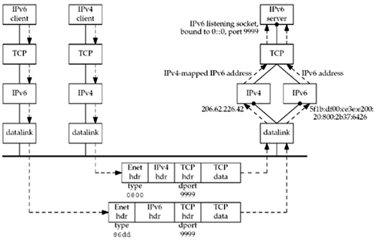

Slide 7
IPV4 Client and IPV6 Server
Step 1. IPV6 Server starts, creates a listening IPV6 socket and it binds wildcard address to
the socket
Step 2. IPV4 client calls gethostbyname and finds an A record..
Steps 3. The Client calls connect and client’s host sends an IPV4 SYN to server
Step 4. The Server host receives IPV4 SYN directed to IPV6 socket, sets a flag indicating
the this connection is using IPV4 mapped IPV6 address and responds with IPV4
SYN/ACK
Step 5. When the server host sends IPV4-mapped-IPV6 address, IP Stack generates IPV4
datagram to IPV4 address
Step 6. Dual Stack handles all the finer details and the Server is unaware that it is
communicating with IPV4 client

Slide 8
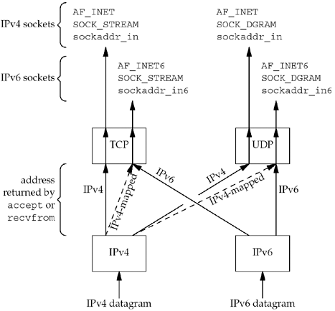
IPV6 Server

Slide 9
IPV6 Client – IPV4 Server
An IPv4 server starts on an IPv4-only host and creates an IPv4 listening socket.
The IPv6 client starts and calls getaddrinfo asking for only IPv6 addresses
it requests the AF_INET6 address family and sets the AI_V4MAPPED flag in its hints structure.
Since the IPv4-only server host has only A records, we see that an IPV4-mapped IPv6 address is returned to the client.
The IPv6 client calls connect with the IPv4-mapped IPv6 address in the IPv6 socket address structure.

Slide 10
IPV6 Client – IPV4 Server
The kernel detects the mapped address and automatically sends an IPv4 SYN to the server.
The server responds with an IPv4 SYN/ACK, and the connection is established using IPv4 datagrams.

Slide 11
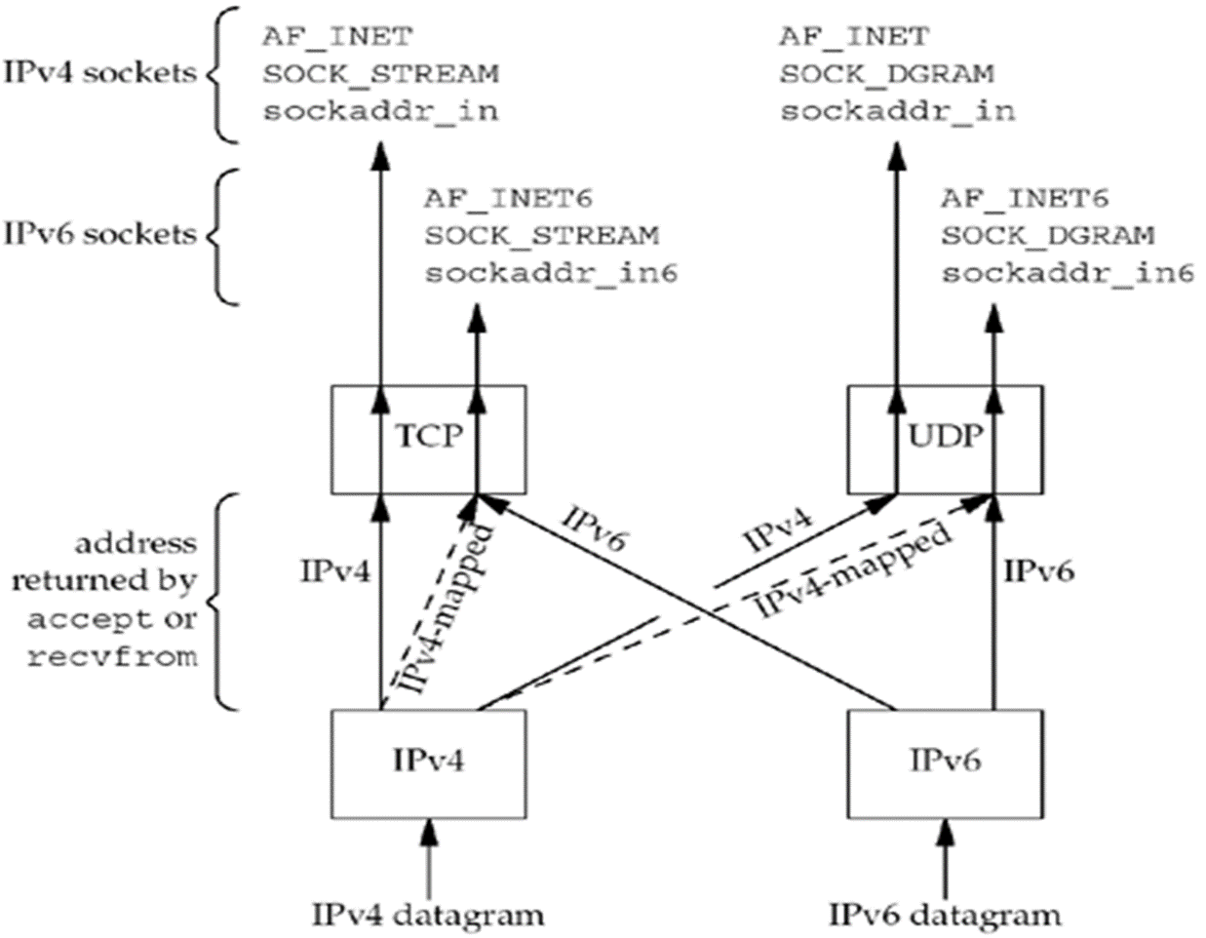
IPV6 Client – IPV4 Server
IPV4 Server
IPV4 Server

Slide 12
IPV4 Client - IPV6 Server
When the server host sends to the IPv4-mapped IPv6 address, its IP stack generates IPv4 datagrams to the IPv4 address. Therefore, all communication between this client and server takes place using IPv4 datagrams.
Unless the server explicitly checks whether this IPv6 address is an IPv4-mapped IPv6 address (using the IN6_IS_ADDR_V4MAPPED macro described in Section 12.4), the server never knows that it is communicating with an IPv4 client.
The dual-protocol stack handles this detail. Similarly, the IPv4 client has no idea that it is communicating with an IPv6 server.

Slide 13
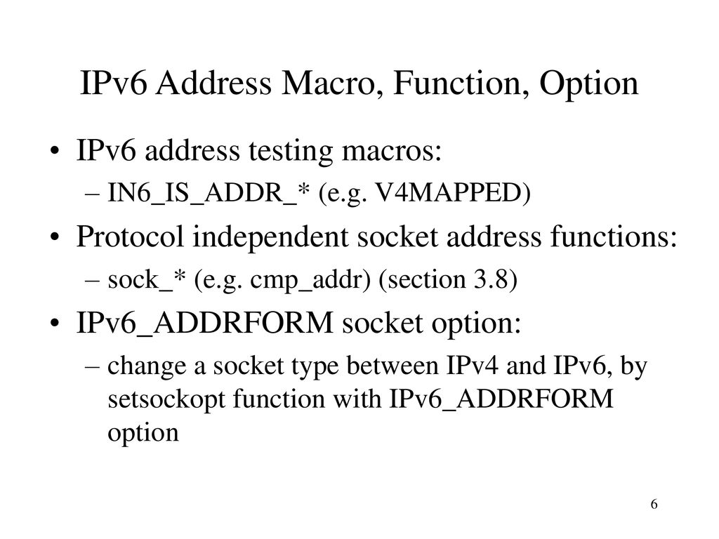
IPV6 Address Testing Macros

Slide 14
IPV6 Address Testing Macros
There are a small class of IPV6 Applications, that must know whether they are communicating with IPV4 peers.
These applications need to know whether the peer is using IPV4 mapped IPV6 address
There are twelve macros that help in this requirement

Slide 15
IPV6 Address Testing Macros
int IN6_IS_ADDR_V4MAPPED(const struct in6_addr *aptr);
int IN6_IS_ADDR_V4COMPAT(const struct in6_addr *aptr);

Slide 16
Source Code Portability
IPV4 Applications can be converted to IPV6 with minor modifications
But we need to check if the recipient host has support for IPV6
We may do this using #ifdefs in the code.. But code will have too many of these #ifdefs
Better way is to make the program protocol independent

Slide 17
Source Code Portability
The first step is… remove all gethostbyname and gethostbyaddr and use
getaddrinfo and getnameinfo functions
This helps deal with sockaddr as opaque objects.

Slide 18
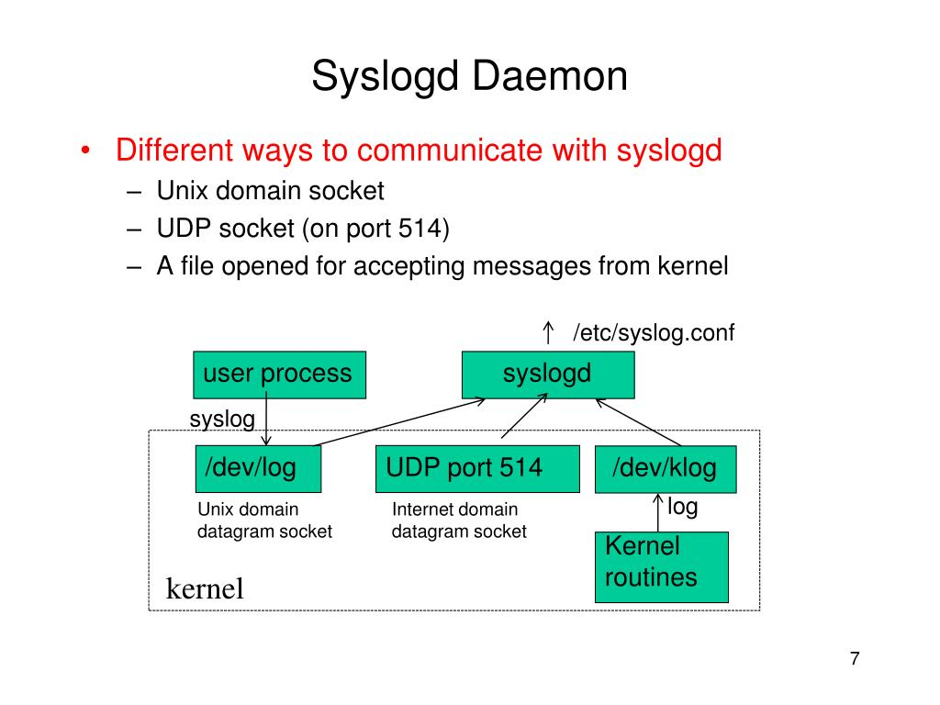
Syslogd Deamon

Slide 19
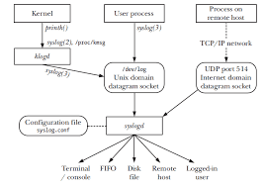

Slide 20
Syslog stands for System Logging Protocol and is a standard protocol used to send system log or event messages to a specific server, called a syslogserver. It is primarily used to collect various device logs from several different machines in a central location for monitoring and review. void syslog(int priorityLevel, char *msg);

Slide 21
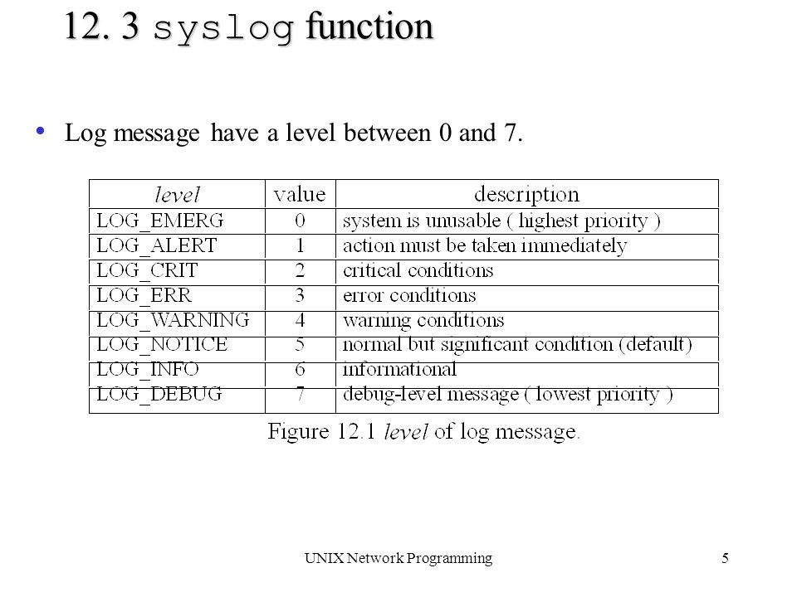
Message Priority Level

Slide 22
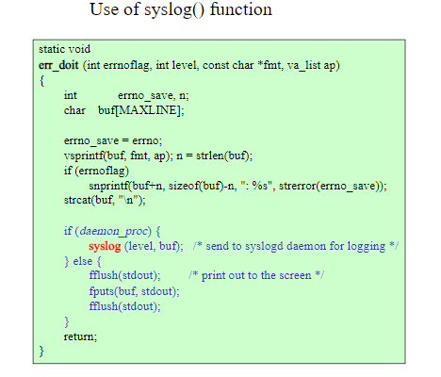

Slide 23
Daemon_init
Fork( )
Parent
Session
exit(0)
Fork( )
Child
Deaomon
setsid( )
signal( )
Child
exit(0)
chdir(“/”)
umask(0)
close(fds)
openlog()

Slide 24
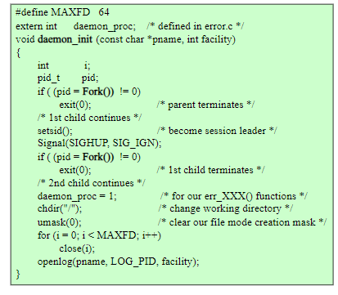
Daemon_init
Facility
LOG_AUTH
security/authorization messages
LOG_AUTHPRIV
security/authorization
messages (private)
LOG_CRON
clock daemon (cron and at)
LOG_DAEMON
system daemons without
separate facility value
LOG_FTP
ftp daemon

Slide 25
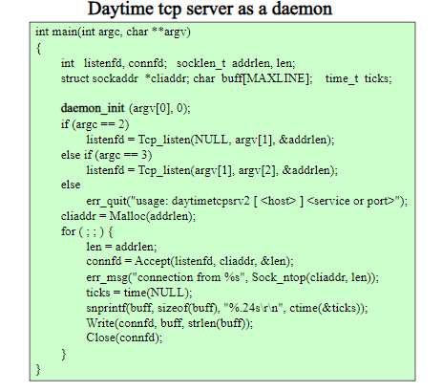

Slide 26
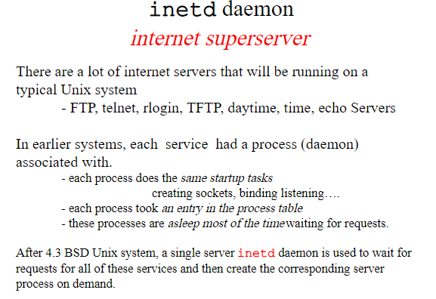

Slide 27
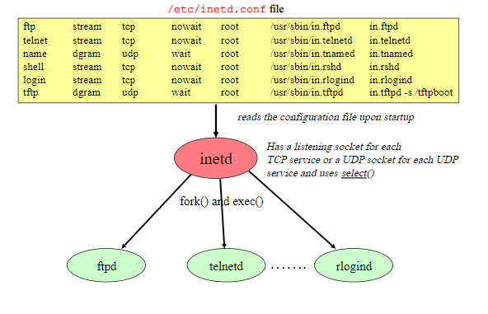
Ftp
Client

Slide 28
